Slide 1
Coursera Applied Data Science Capstone Project
Denver Restaurant Placement Analysis
By John Corr

Slide 2
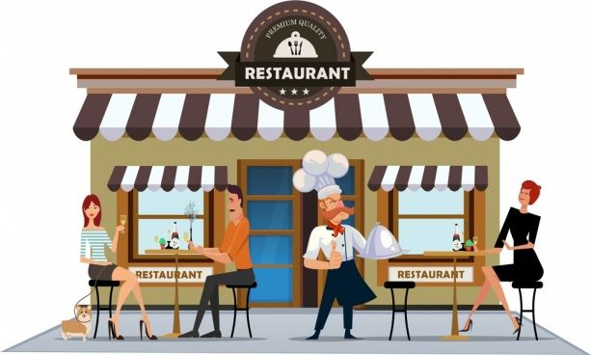
Introduction
Restaurant industry very cut throat
Placement key to ensure financial viability
Project focuses on Denver, Colorado
Project objective is to analyze the prevalence of various types of venues in the fifty-six major neighborhoods of Denver to assist prospective business owners with ideal restaurant location

Slide 3
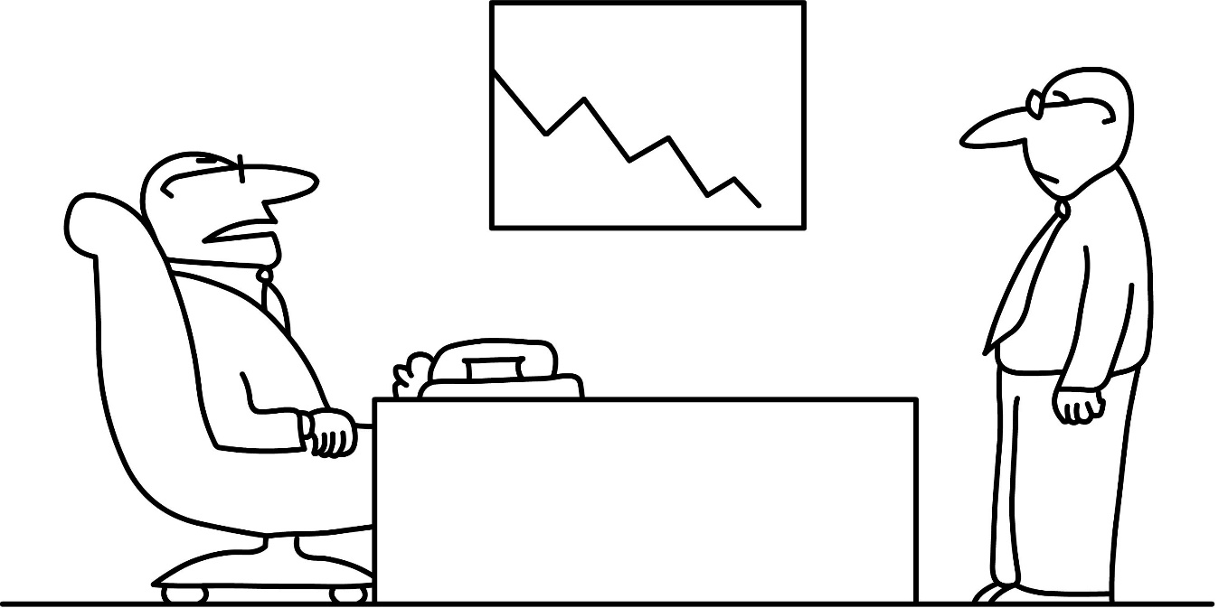
Data
Neighborhood Data – Wikipedia: “List of Neighborhoods in Denver” (https://en.wikipedia.org/wiki/List_of_neighborhoods_in_Denver)
Venue Information – Foursquare

Slide 4
Methodology & Results
Python Libraries/Packages: pandas, numpy, json, geopy.geocoders, folium, matplotlib, Kmeans, Beautiful Soup
Beautiful Soup – scrape data from Wikipedia page
Geopy.geocoders – pull GPS coordinates for each of the 56 neighborhoods
Folium – generate map to display location of neighborhoods in Denver
Foursquare – call to the Foursquare API to get venues information for Denver
Grouped venues into categories
Used GPS coordinates to sort venues by neighborhood
OneHot Encoding – determined numerical frequency of venues in each neighborhood
K Means – cluster data and put in readable table that shows 10 most common venues in a neighborhoods

Slide 5
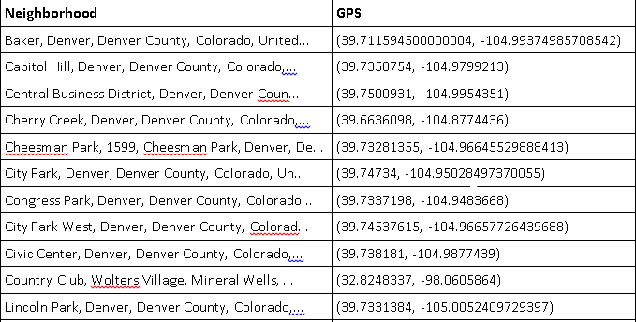
Methodology & Results (cont’d)
Portion of Table Showing Neighborhoods with their GPS Coordinates

Slide 6
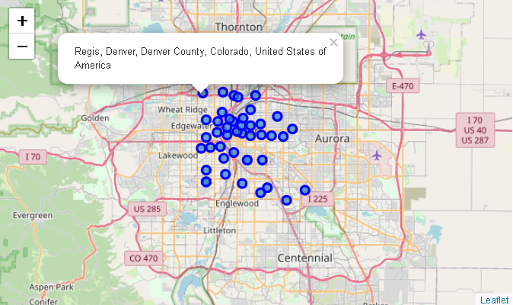
Methodology & Results (cont’d)
Folium Map Depecting Neighborhoods in Denver with Labels

Slide 7
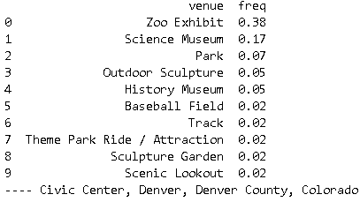
Methodology & Results (cont’d)
Frequency of Venues in Each Neighborhood

Slide 8
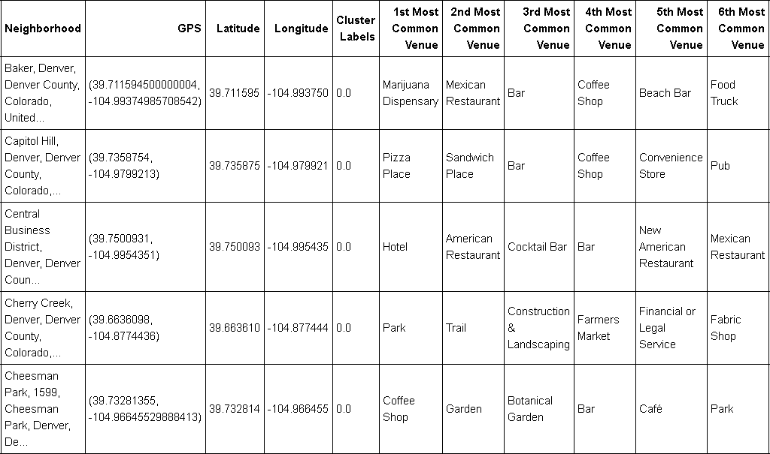
Methodology & Results (cont’d)
Portion of Most Common 10 Venues by Neighborhood Table

Slide 9
Discussion & Conclusion
Presented information in various methods to suit data visualization preferences of any potential business owner
Presented numerically, graphically, tabular, visually
Table – presents clearest and quickest representation of the information
Foluim map – good starting point to get geographically acquainted with the area

